Slide 1
Appendix Technical Slides

Slide 2
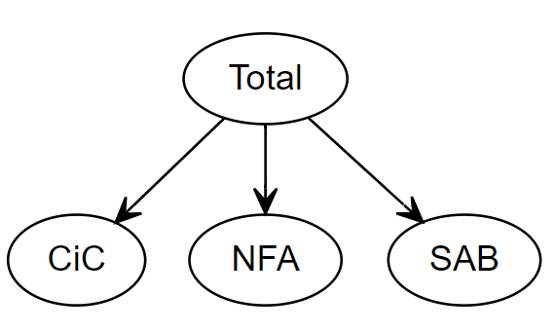
Hierarchical Forecasts of the Autonomous Factors
Forecast the autonomous factors using a hierarchical modeling approach, with different models for each AF
Forecasting the sum of the autonomous factors separately
Reconciling the forecasts using aggregation technics as described for instance in Hyndman, Rob J., et al. "Optimal combination forecasts for hierarchical time series." (2011)
Use either OLS computation of the weights or the “minT” approach: minimize the trace of the VarCov forecast matrix. Exploit the covariance among regressors to maximize the accuracy

Slide 3
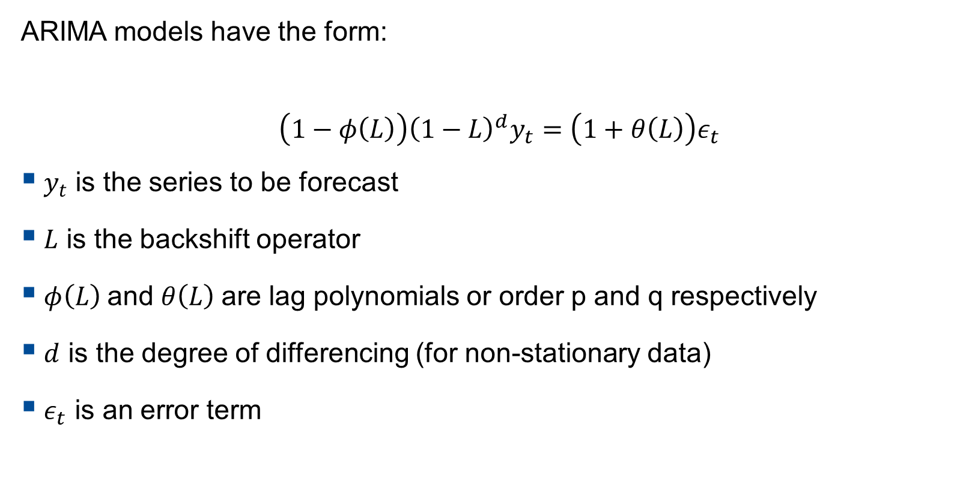
ARIMA Model
ARIMA models have the form:
$$\left(1−φ\left(L\right)\right){\left(1−L\right)}^{d}y_{t}=\left(1+θ\left(L\right)\right)ε_{t}$$
$y_{t}$ is the series to be forecast
$L$ is the backshift operator
$φ\left(L\right)$and $θ\left(L\right)$are lag polynomials or order p and q respectively
$d$ is the degree of differencing (for non-stationary data)
$ε_{t}$ is an error term

Slide 4
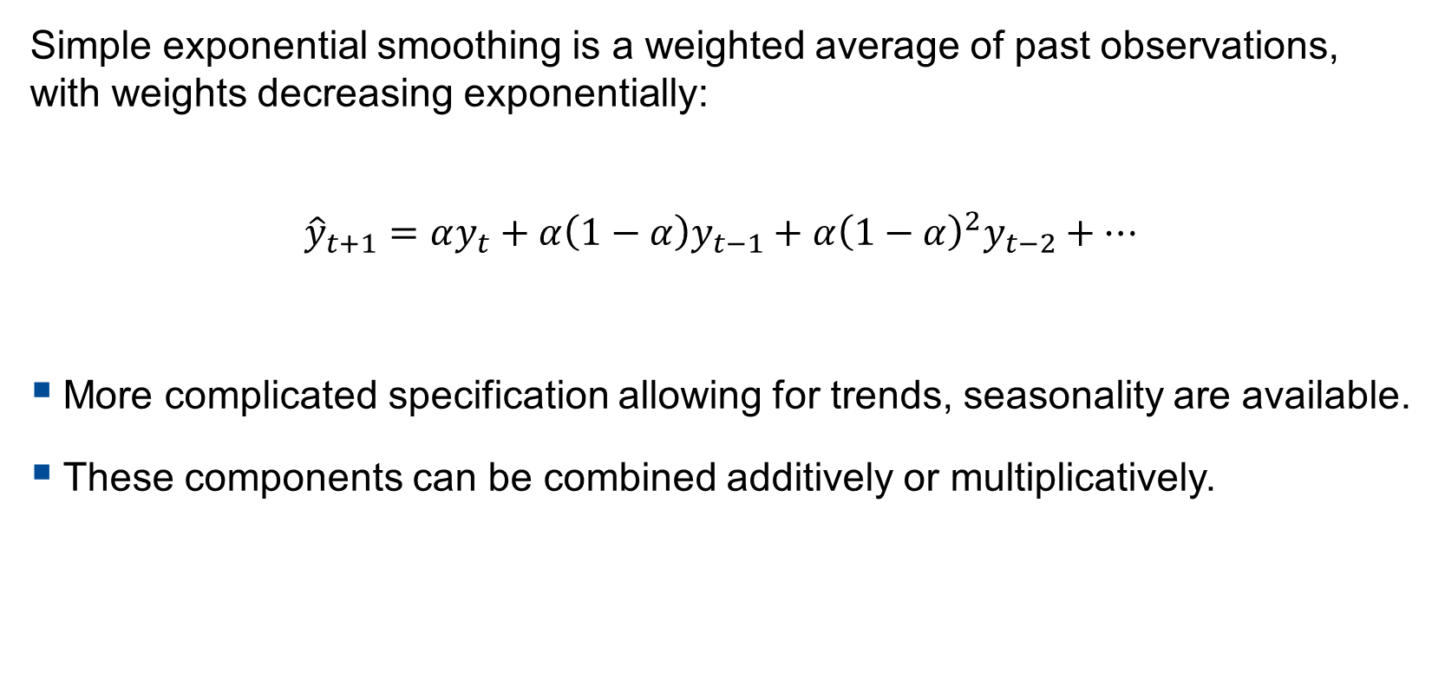
ETS (Exponential Smoothing) Model
Simple exponential smoothing is a weighted average of past observations, with weights decreasing exponentially:
$${\hat{y}}_{t+1}=αy_{t}+α\left(1−α\right)y_{t−1}+α{\left(1−α\right)}^{2}y_{t−2}+…$$
More complicated specification allowing for trends, seasonality are available.
These components can be combined additively or multiplicatively.

Slide 5

Advanced Models – ARIMA with Trigonometric Seasonality
ARIMA with trigonometric seasonality
ARIMA trig A: first estimate coefficients of $X_{t}$ and $D_{t}$ and then estimate ARIMA part (it is a regARIMA model)
ARIMA trig B: jointly estimate all coefficients

Slide 6
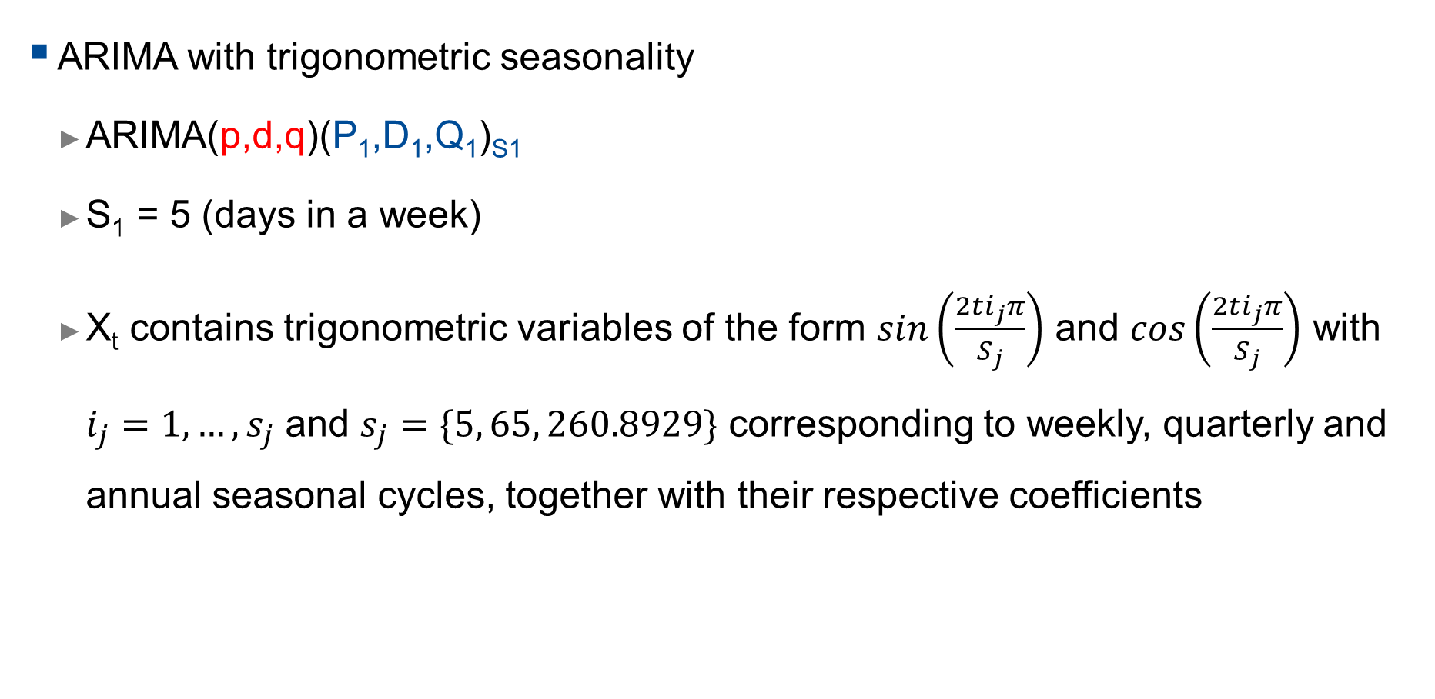
Advanced Models – ARIMA with Trigonometric Seasonality
ARIMA with trigonometric seasonality
ARIMA(p,d,q)(P₁,D₁,Q₁)_{S1}
S₁ = 5 (days in a week)
X_{t} contains trigonometric variables of the form $sin\left(\frac{2ti_{j}π}{S_{j}}\right)$ and $cos\left(\frac{2ti_{j}π}{S_{j}}\right)$ with $i_{j}=1, …, s_{j}$ and $s_{j}=\{5, 65, 260.8929\}$ corresponding to weekly, quarterly and annual seasonal cycles, together with their respective coefficients
$${\left(1−\sum_{i=1}^{p}{φ_{i}B^{i}}\right)\left(1−\sum_{k=1}^{P1}{{Φ1}_{k}B^{s1k}}\right)\left(1−B\right)}^{d}{\left(1−B^{s1}\right)}^{D1}Y_{t}=\left(1−\sum_{j=1}^{q}{θ_{j}B^{j}}\right)\left(1−\sum_{l=1}^{Q1}{{Θ1}_{l}B^{s1l}}\right)ε_{t}+Xt+D_{t}$$

Slide 7
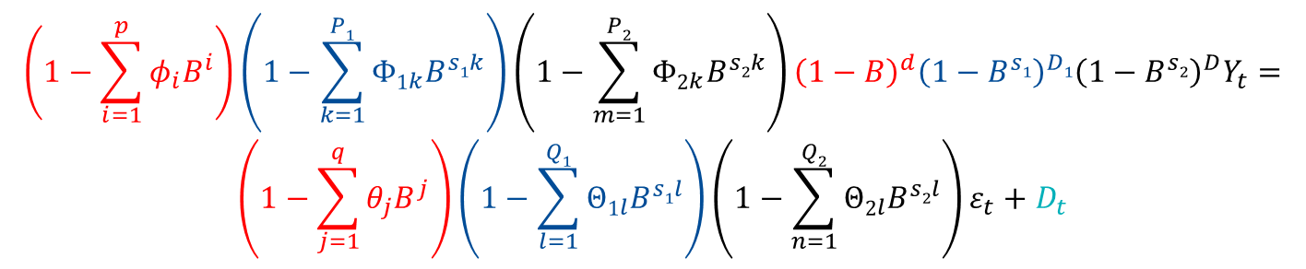
Advanced Models - ARIMA
ARIMA with multiple stochastic seasonality
ARIMA(p,d,q)(P₁,D₁,Q₁)_{S1}(P₂,D₂,Q₂)_{S2}
S₁ = 5 (days in a week)
S₂ = 5*13 (days in a quarter, 13 weeks)
$${\left(1−\sum_{i=1}^{p}{φ_{i}B^{i}}\right)\left(1−\sum_{k=1}^{P1}{{Φ1}_{k}B^{s1k}}\right)\left(1−\sum_{m=1}^{P2}{{Φ2}_{k}B^{s2k}}\right)\left(1−B\right)}^{d}{\left(1−B^{s1}\right)}^{D1}{\left(1−B^{s2}\right)}^{D}Y_{t}=$$
$$\left(1−\sum_{j=1}^{q}{θ_{j}B^{j}}\right)\left(1−\sum_{l=1}^{Q1}{{Θ1}_{l}B^{s1l}}\right)\left(1−\sum_{n=1}^{Q2}{{Θ2}_{l}B^{s2l}}\right)ε_{t}+D_{t}$$

Slide 8
Advanced Model: TBATS model
Combines in a single state-space model:
Exponential smoothing to model level and trend
Trigonometric terms to account for seasonality
Box-Cox transformation to account for non-normality
ARIMA errors to model the residuals dynamic
The TBATS model has appealing properties but, for some countries, tend to underperform simpler models (trigonometric ARIMA for instance). For some other countries, it performs very well

Slide 9
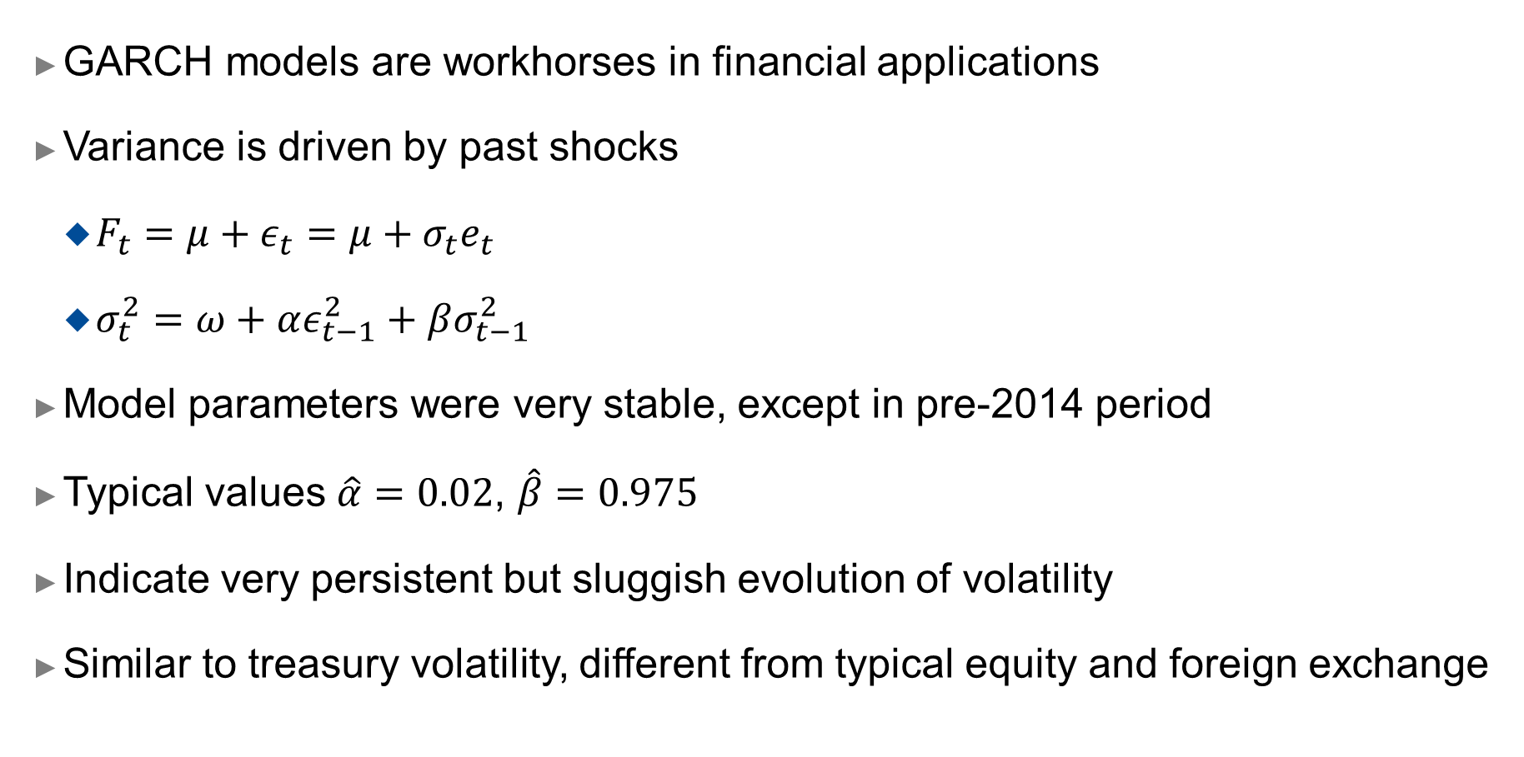
GARCH Models
GARCH models are workhorses in financial applications
Variance is driven by past shocks
$F_{t}=μ+ε_{t}=μ+σ_{t}e_{t}$
$σ_{t}^{2}=ω+αε_{t−1}^{2}+βσ_{t−1}^{2}$
Model parameters were very stable, except in pre-2014 period
Typical values $\hat{α}=0.02$, $\hat{β}=0.975$
Indicate very persistent but sluggish evolution of volatility
Similar to treasury volatility, different from typical equity and foreign exchange

Slide 10
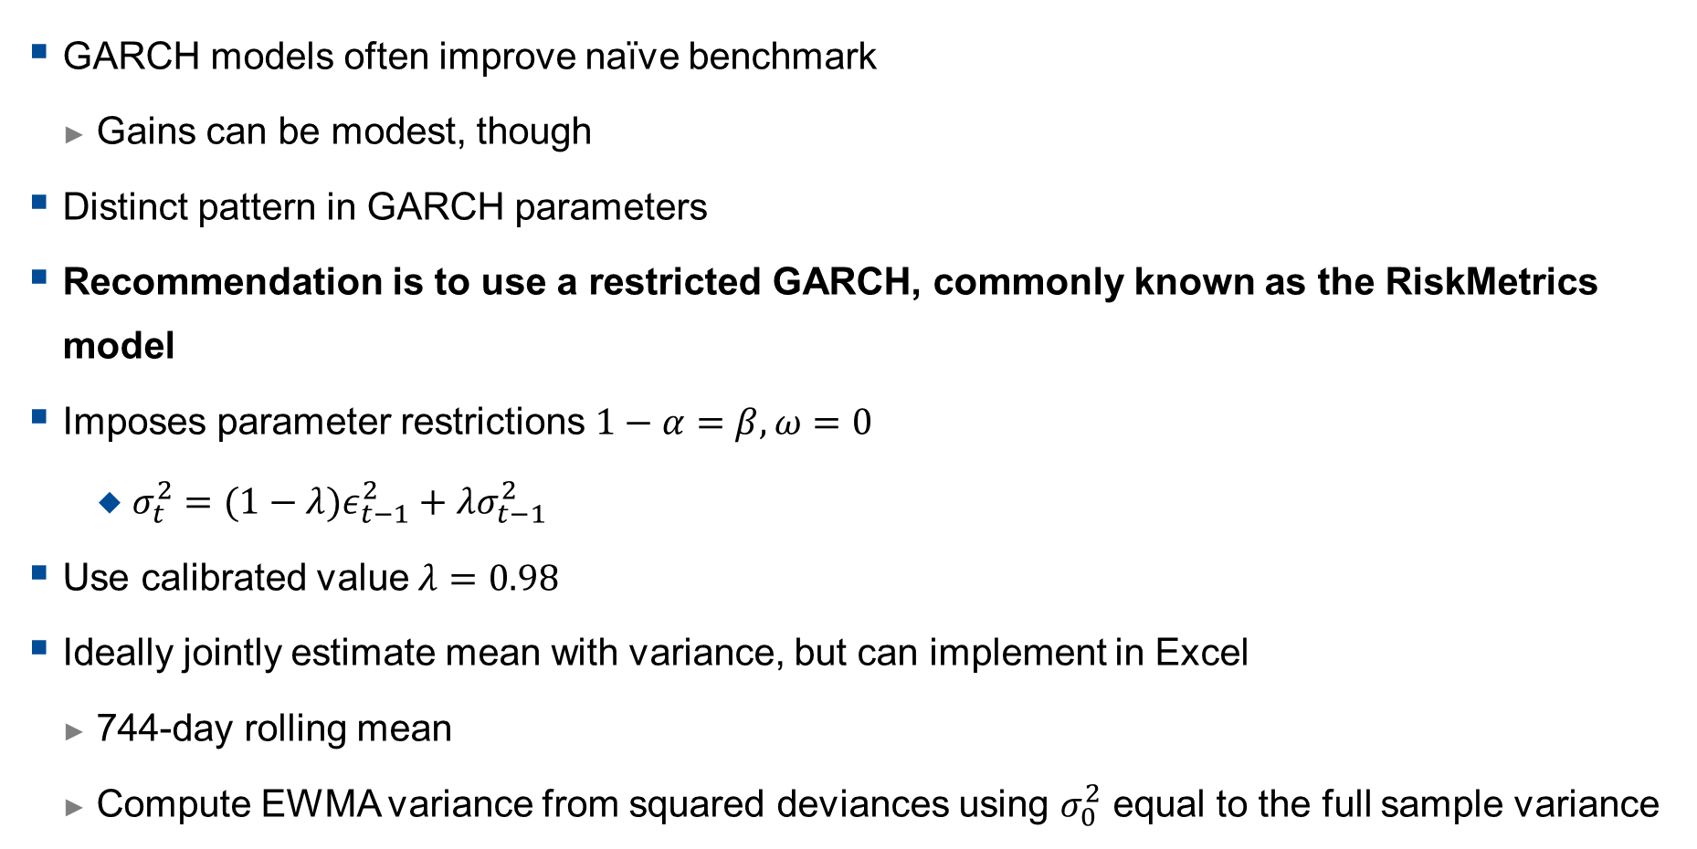
GARCH versus EWMA
GARCH models often improve naïve benchmark
Gains can be modest, though
Distinct pattern in GARCH parameters
Recommendation is to use a restricted GARCH, commonly known as the RiskMetrics model
Imposes parameter restrictions $1−α=β,ω=0$
$σ_{t}^{2}=(1−λ)ε_{t−1}^{2}+λσ_{t−1}^{2}$
Use calibrated value $λ=0.98$
Ideally jointly estimate mean with variance, but can implement in Excel
744-day rolling mean
Compute EWMA variance from squared deviances using $σ_{0}^{2}$ equal to the full sample variance

Slide 11
Terms Elimination and Trigonometric Seasonality
Elimination of seasonal terms:
Eliminating terms from the binary (indicator variable) representation, removes the effect of seasonal periods.
Eliminating terms in the trigonometric representation results in smoother approximations of the seasonal shape.
Elimination of terms can be done using information criteria
Besides, trigonometric representation is more parsimonious, as it involves less parameters to estimate: reduce parametric noise

Slide 12
Expanding Window Setup
Construct a rolling window of 780 observations (approx. 3 years).
First window, for instance 3/1/2012-10/2/2015,
For each model class, select and estimate model,
Produce forecasts from 1-day ahead to 20-days ahead (11/2/2015-10/3/2015).
Roll window forwards by one day:
Second window 3/1/2012-11/2/2015,
Reselect and restimate models,
Produce forecasts from 1-day ahead to 20-days ahead (12/2/2015-11/3/2015).
This is repeated until all data is used.

Slide 13
Performance Evaluation
A visual example of the rolling origin evaluation for a single model. At each origin, the model is re-specified fully, potentially changing form and parameters.

Slide 14
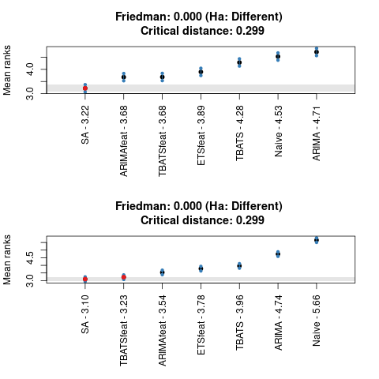
Example: State Account Forecasts Statistical Significance
When ranks are considered, Simple Average, significantly outperforms other models (mostly),
Top plot on right shows 5-day ahead forecasts,
Bottom plot on right shows 20-day ahead forecasts.

Slide 15
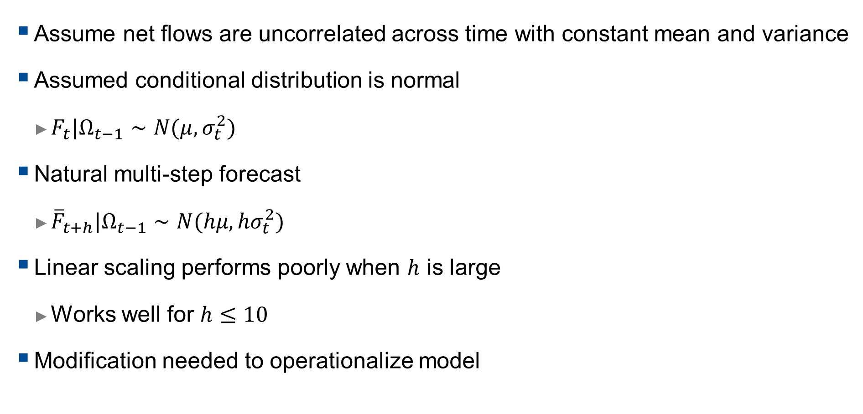
Baseline Model
Assume net flows are uncorrelated across time with constant mean and variance
Assumed conditional distribution is normal
$F_{t}|Ω_{t−1}∼N(μ,σ_{t}^{2})$
Natural multi-step forecast
${\overline{F}}_{t+h}|Ω_{t−1}∼N(hμ,hσ_{t}^{2})$
Linear scaling performs poorly when $h$ is large
Works well for $h≤10$
Modification needed to operationalize model

Slide 16
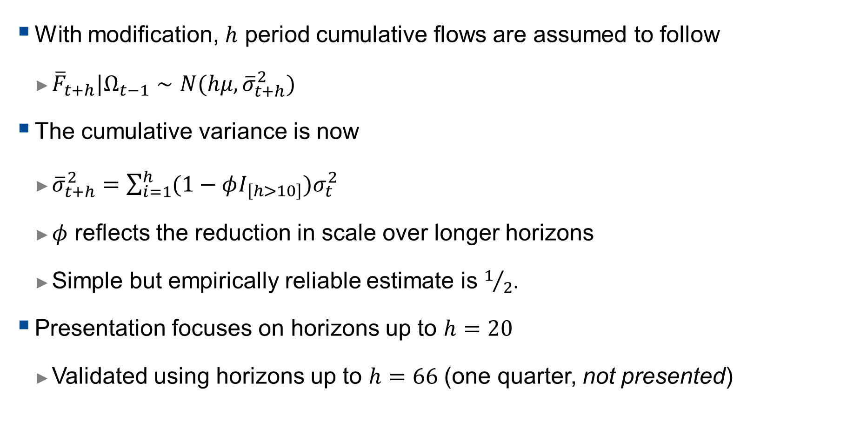
Modified multi-step density forecast
With modification, $h$ period cumulative flows are assumed to follow
${\overline{F}}_{t+h}|Ω_{t−1}∼N(hμ, {\overline{σ}}_{t+h}^{2})$
The cumulative variance is now
${\overline{σ}}_{t+h}^{2}=\sum_{i=1}^{h}{(1−φI_{\left[h>10\right]})σ_{t}^{2}}$
$φ$ reflects the reduction in scale over longer horizons
Simple but empirically reliable estimate is $1/2$.
Presentation focuses on horizons up to $h=20$
Validated using horizons up to $h=66$ (one quarter, not presented)

Slide 17
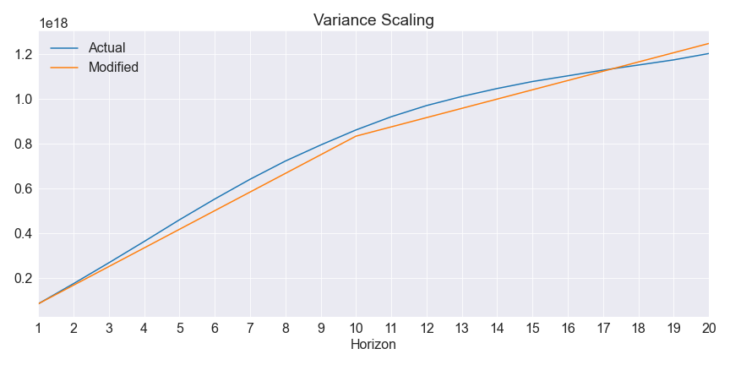
Modified Variance Scaling

Slide 18
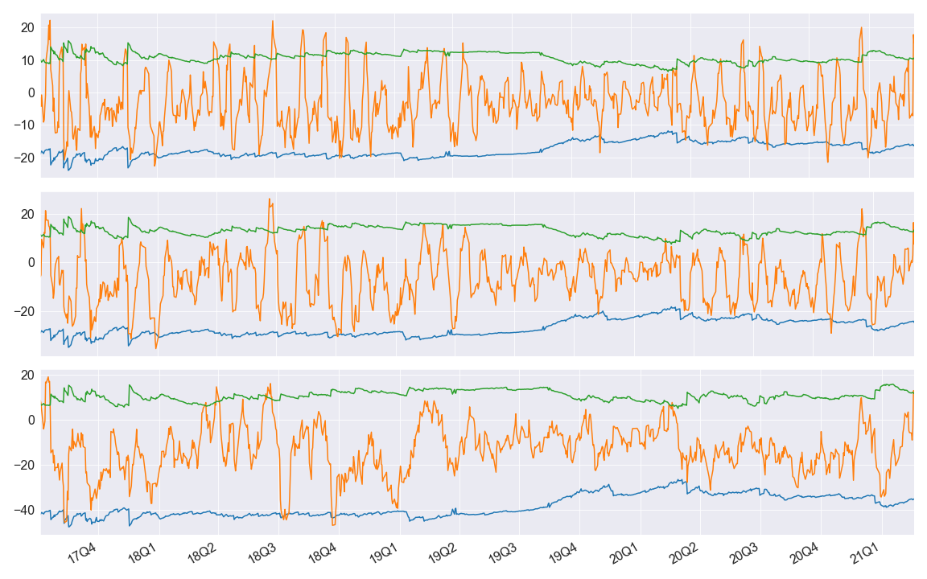
GARCH Model Performance (95%)

Slide 19
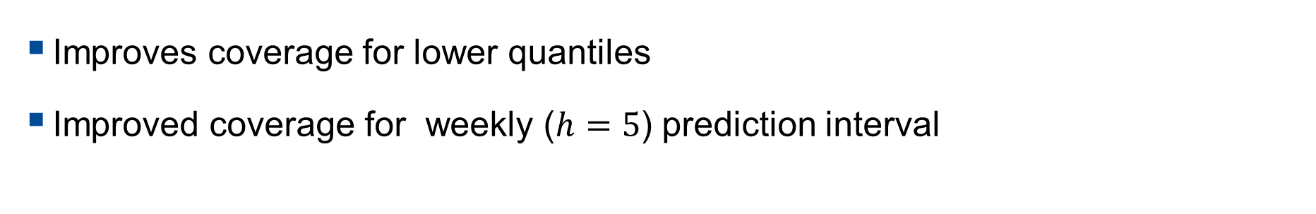
GARCH Model Performance
 | h=5 | h=10 | h=20
78 | 72.5 | 74.9 | 84.8
90 | 86.5 | 88.8 | 92.6
95 | 91.8 | 95.6 | 96.9
99 | 97.3 | 98.6 | 99.4
Improves coverage for lower quantiles
Improved coverage for weekly ($h=5$) prediction interval

